Slide 1
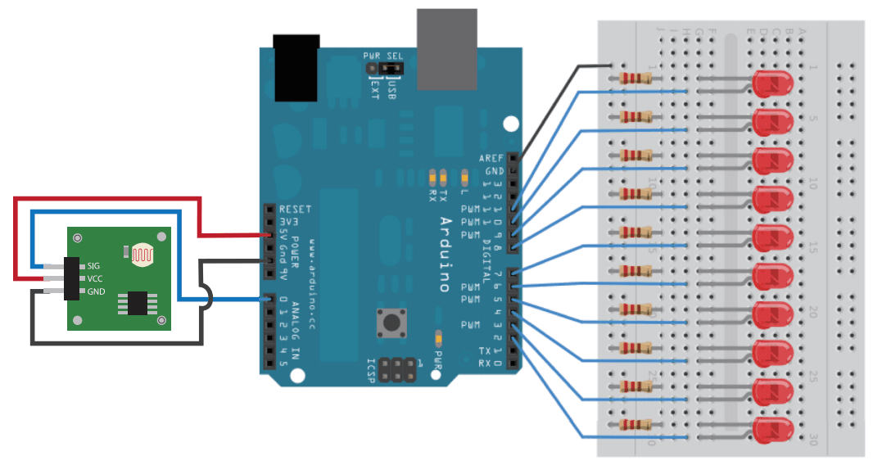
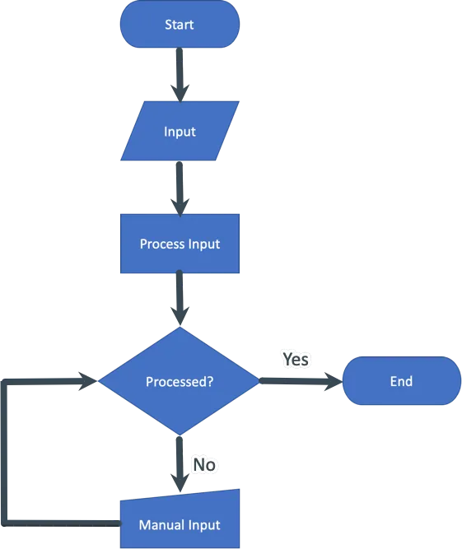
Institucional
Logo 1
Title of the research
Institucional
Logo 2
Firstname, Lastname ¹, Firstname, Lastname ² and Firstname, Lastname ³ ¹Affiliation 1; ²Affiliation 2; ³Affiliation 3; contact: e-mail@e-mail.com
Problem Statement. Here, you should describe the main issue motivating the research, providing relevant context and examples. Write in the third person, include supporting data or evidence to demonstrate the significance of the problem, and outline its broader impact. Highlight any existing solutions or gaps and connect the problem directly to the research objective. [no more than 150 words]
Project Proposal
Results
Here you describe the proposal of your work.
Present your findings clearly, focusing on visuals like graphs, tables, or diagrams to illustrate key outcomes. Use captions or brief descriptions to highlight the main insights.
Key Metrics: Include statistical measures, percentages, or averages to summarize results.
Example: Intraclass Correlation Coefficient (ICC) of 0.92 indicates high concordance (llustrated with a diagram comparing prototype and commercial device readings)..
Visual Representation: Use graphs or charts to compare data (e.g., Bland-Altman plot, bar charts, etc.).
Ensure visuals are labeled and easy to interpret.
Conclusions from Visuals: Add a short statement summarizing what the visuals demonstrate.
Example: Prototype measurements closely align with the commercial device.
Example.
In this area, we recommend including diagrams, prototype designs, flowcharts, or the most relevant visual products of your research. For example:
Fig. 1. Simple Light Sensor Circuit.
Fig. 2. simple flow chart for process input.
Prototype Diagram
Operation Flow Diagram
Bland-Altman Coefficient
Fig. 4. Measurements obtained with a prototype and a medical equipment. The Bland-Altman plots shown to validate the precision of the prototype.
Methodology
Conclusions
Describe the methods used in your research as clear steps or bullet points. Focus on key actions and processes, such as:
Data Collection: Specify how and from whom data was gathered (e.g., participants, equipment).
Processing: Briefly explain how data was managed (e.g., visualization, storage).
Analysis: Highlight statistical methods or techniques used for evaluation.
Validation: Summarize steps to confirm accuracy or reliability.
Keep each step concise
In this section, include the conclusions of the research.
References
Here, include the main references for the problem statement.
Notes:
Notes:
* Logo 2 only if aplicable
* For contact, up to 2 mails maximum

